Slide 1
2021-2022 School Year
Madame Wilder

Slide 2

Welcome to the New School Year! Hi! I’m Mrs. Wilder! I love world language and love teaching students about it! I can’t wait to get this school year started!

Slide 3
What We Will Learn!
Our syllabus is packed with the skills we need to learn this year! Find your syllabus below:
6th Grade French - https://madamewilder.weebly.com/6th-grade-french.html
6th Grade Spanish - https://madamewilder.weebly.com/6th-grade-spanish.html
French 1A - https://madamewilder.weebly.com/french-1a-syllabus.html
French 1B - https://madamewilder.weebly.com/french-1b-syllabus.html
French 2 - https://madamewilder.weebly.com/french-2-syllabus.html

Slide 4
How We Will Learn!
We will speak, read, write, and listen to the language while learning grammar, culture, geography, literature, and history in the following ways:
reading aloud, white board practice, culture projects, youtube videos/creating videos, chants, songs, skits, maps, drawing cartoons, listening comprehension practice, games, dancing/acting, conversation and dialogues in pairs/groups/whole group, complex text-translations, pronunciation guides, graphic organizers, pictures to describe/manipulatives, worksheets, charts, vocabulary repetition, persuasive essays, teaching stations, textbook pages, food, and class celebrations

Slide 5
How Will I Be Graded?
In class we will have: The procedures for these are:
Classwork/Homework- at least two per week, skill mastery
Quizzes- once every two weeks, handwritten
Project Presentations- one or two per quarter, Google Slides
Memorization Passages- one per semester, presented in class
Semester Exam- one per semester, comprehensive
Percentages for these categories are based on Houston Academy guidelines.

Slide 6
Where Will I Find My Assignments?
You will find your assignments on Google Classroom and also madamewilder.weebly.com
You may also frequently check PowerSchool to see upcoming posted assignments.
Google Classroom Codes:
6th Grade French - eahzp4r
6th Grade Spanish - jomjhs3
French 1A - rdf3tnv
French 1B - reowi4k
French 2 - nopzqa7

Slide 7
What Do I Need for Class?
When you visit the syllabus page for your class you will see what you need at the top of the page!
6th Grade French - https://madamewilder.weebly.com/6th-grade-french.html
6th Grade Spanish - https://madamewilder.weebly.com/6th-grade-spanish.html
French 1A - https://madamewilder.weebly.com/french-1a-syllabus.html
French 1B - https://madamewilder.weebly.com/french-1b-syllabus.html
French 2 - https://madamewilder.weebly.com/french-2-syllabus.html

Slide 8
Do I Get Rewarded For Good Behavior?
What IS Good Behavior?
Yes! I love to teach culture through food. We will have parties for good behavior at least three times a semester!
Good behavior is paying attention in class, respecting the teacher and respecting your classmates. Everything you say in class should be kind, necessary, and true. All three, all the time.
What happens if I don’t follow the rules? You will be disciplined according to the guidelines set by Houston Academy. I also have to right to take away planned parties.

Slide 9
Why Do I Need to Study World Language Anyway?
Twenty-five Reasons to Study Foreign Languages (This is not my original content but I agree with every word. I took this from the internet!)
Foreign Language study creates more positive attitudes and less prejudice toward people who are different.
Analytical skills improve when students study a foreign language.
Business skills plus foreign language skills make an employee more valuable in the marketplace.
Dealing with another culture enables people to gain a more profound understanding of their own culture.
Creativity is increased with the study of foreign languages.
Graduates often cite foreign language courses as some of the most valuable courses in school because of the communication skills developed in the process.
International travel is made easier and more pleasant through knowing a foreign language.
Skills like problem solving and dealing with abstract concepts are increased when you study a foreign language.
Foreign language study enhances one’s opportunities in government, business, medicine, law, technology, military, industry, marketing, etc.
A second language improves your skills and grades in math and English and on the SAT and GRE.
Four out of five new jobs in the US are created as a result of foreign trade.
Foreign languages provide a competitive edge in career choices: one is able to communicate in a second language.
Foreign language study enhances listening skills and memory.
One participates more effectively and responsibly in a multi-cultural world if one knows another language.
Your marketable skills in the global economy are improved if you master another language.
Foreign language study offers a sense of the past - culturally and linguistically.
The study of a foreign tongue improves the knowledge of one’s own language: English vocabulary skills increase.
The study of foreign languages teaches and encourages respect for other peoples: it fosters an understanding of the interrelation of language and human nature.
Foreign languages expand one’s view of the world, expands one’s experiences, and makes one more flexible and tolerant.
Foreign languages expand one’s world view and limit the barriers between people: barriers cause distrust and fear.
Foreign language study leads to an appreciation of cultural diversity.
As immigration increases we need to prepare for changes in American society.
One is at a distinct advantage in the global market if one is as bilingual as possible.
Foreign languages open the door to art, music, dance, fashion, cuisine, film, philosophy, science.
Foreign language study is simply part of a very basic education: to “educate” is to lead out, to lead out of confinement and narrowness and darkness.

Slide 10
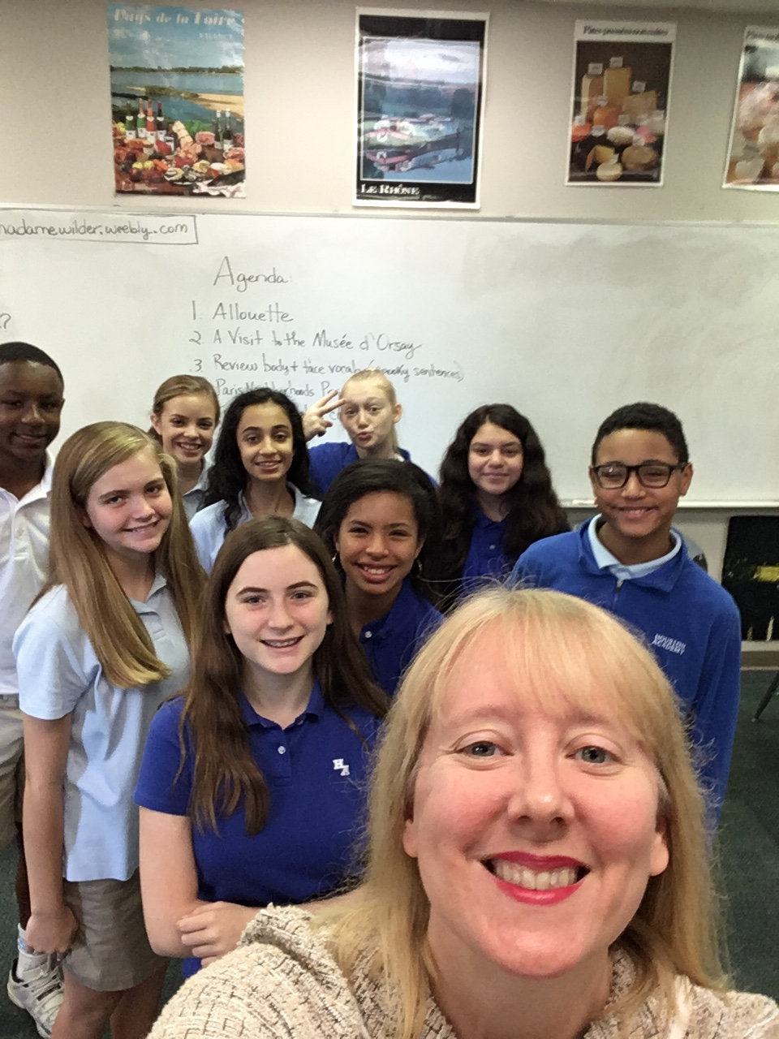
Let’s have a great year! Allons-y!!

